Slide 1
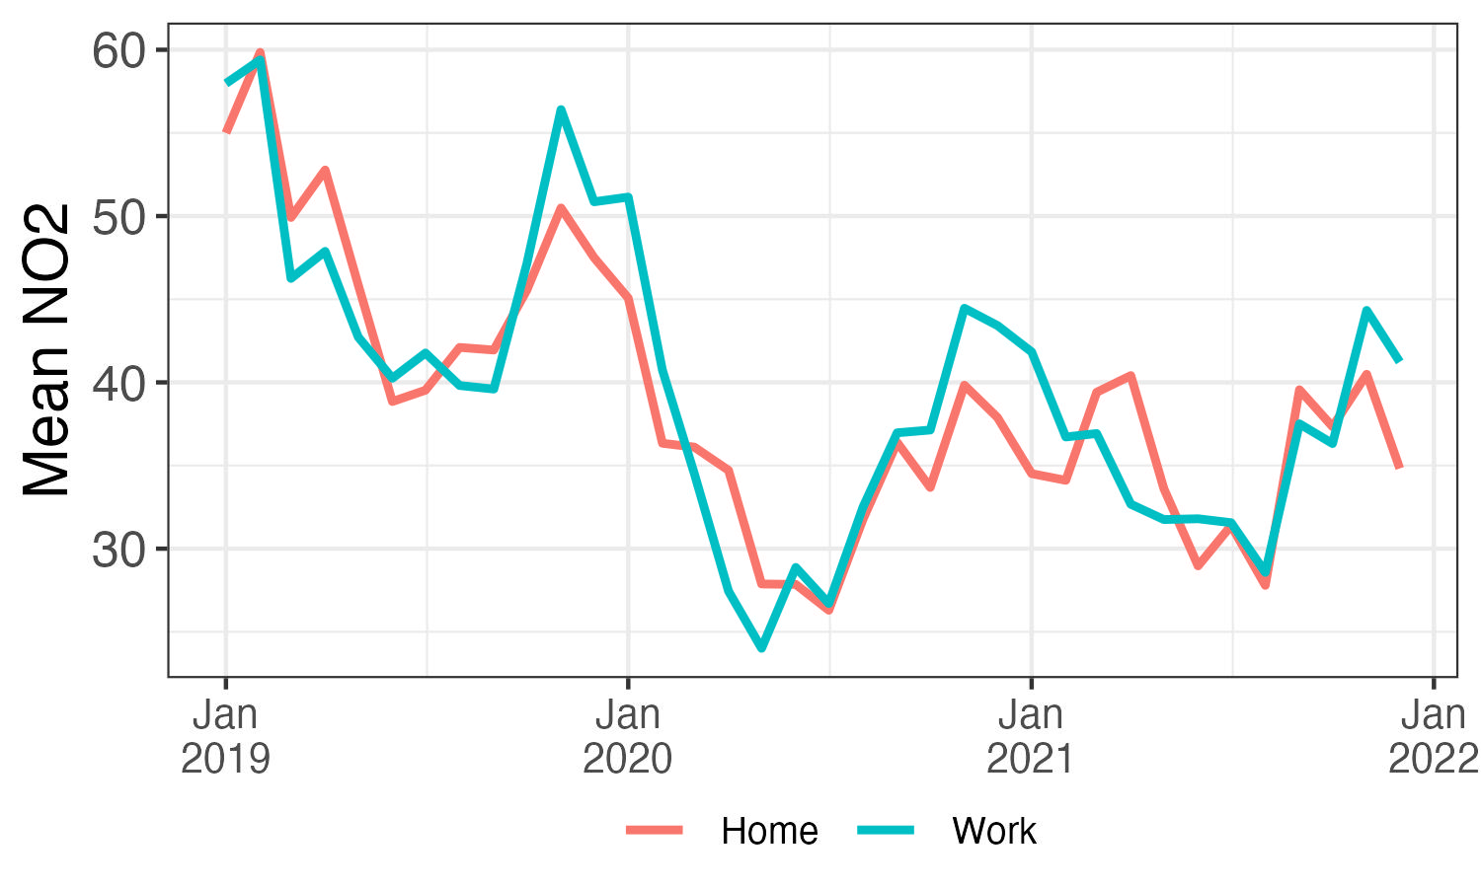
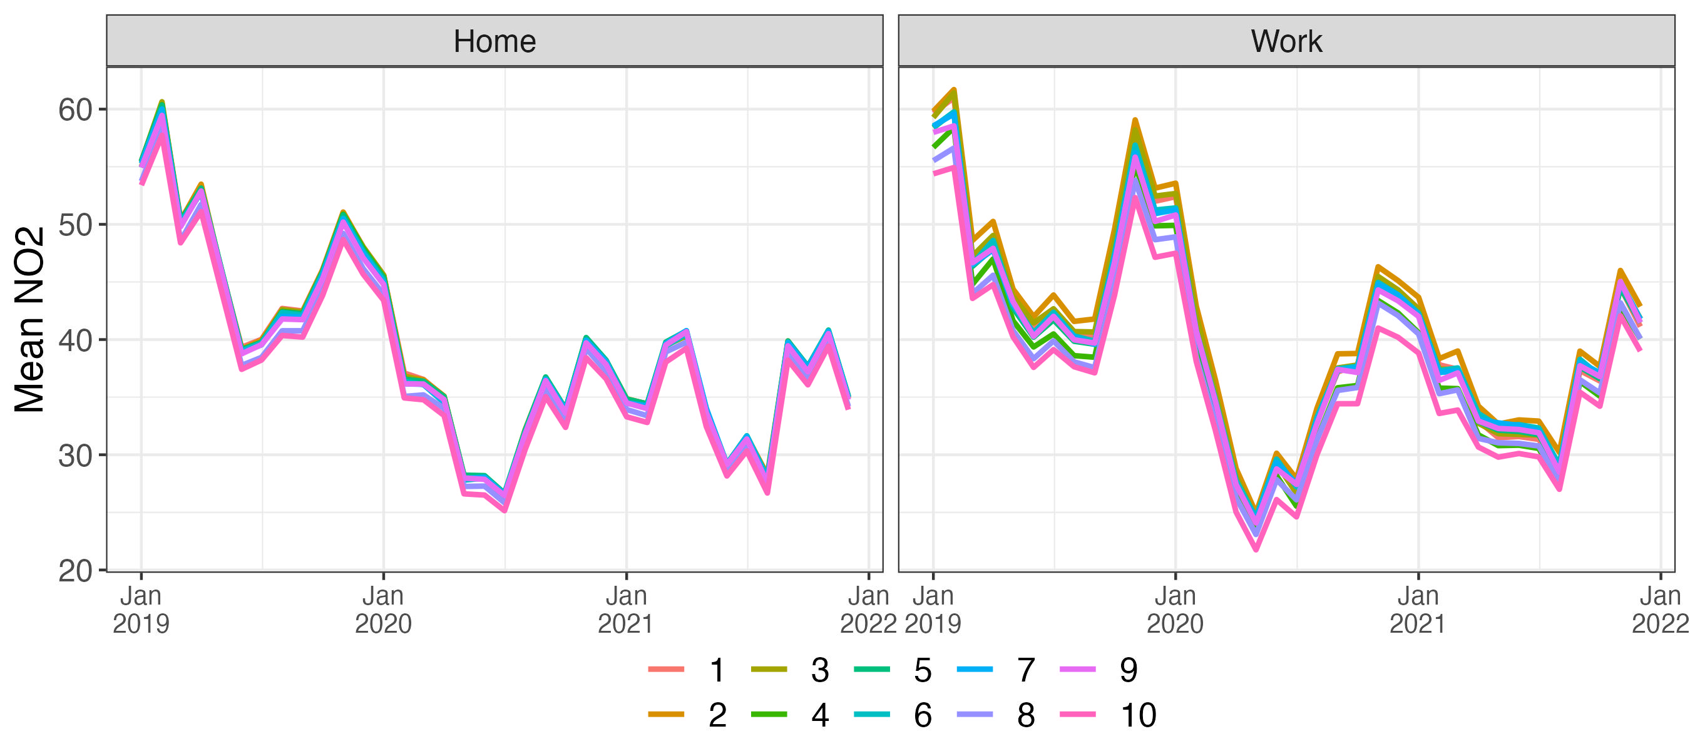
A
B
More deprived
Less deprived

Slide 2
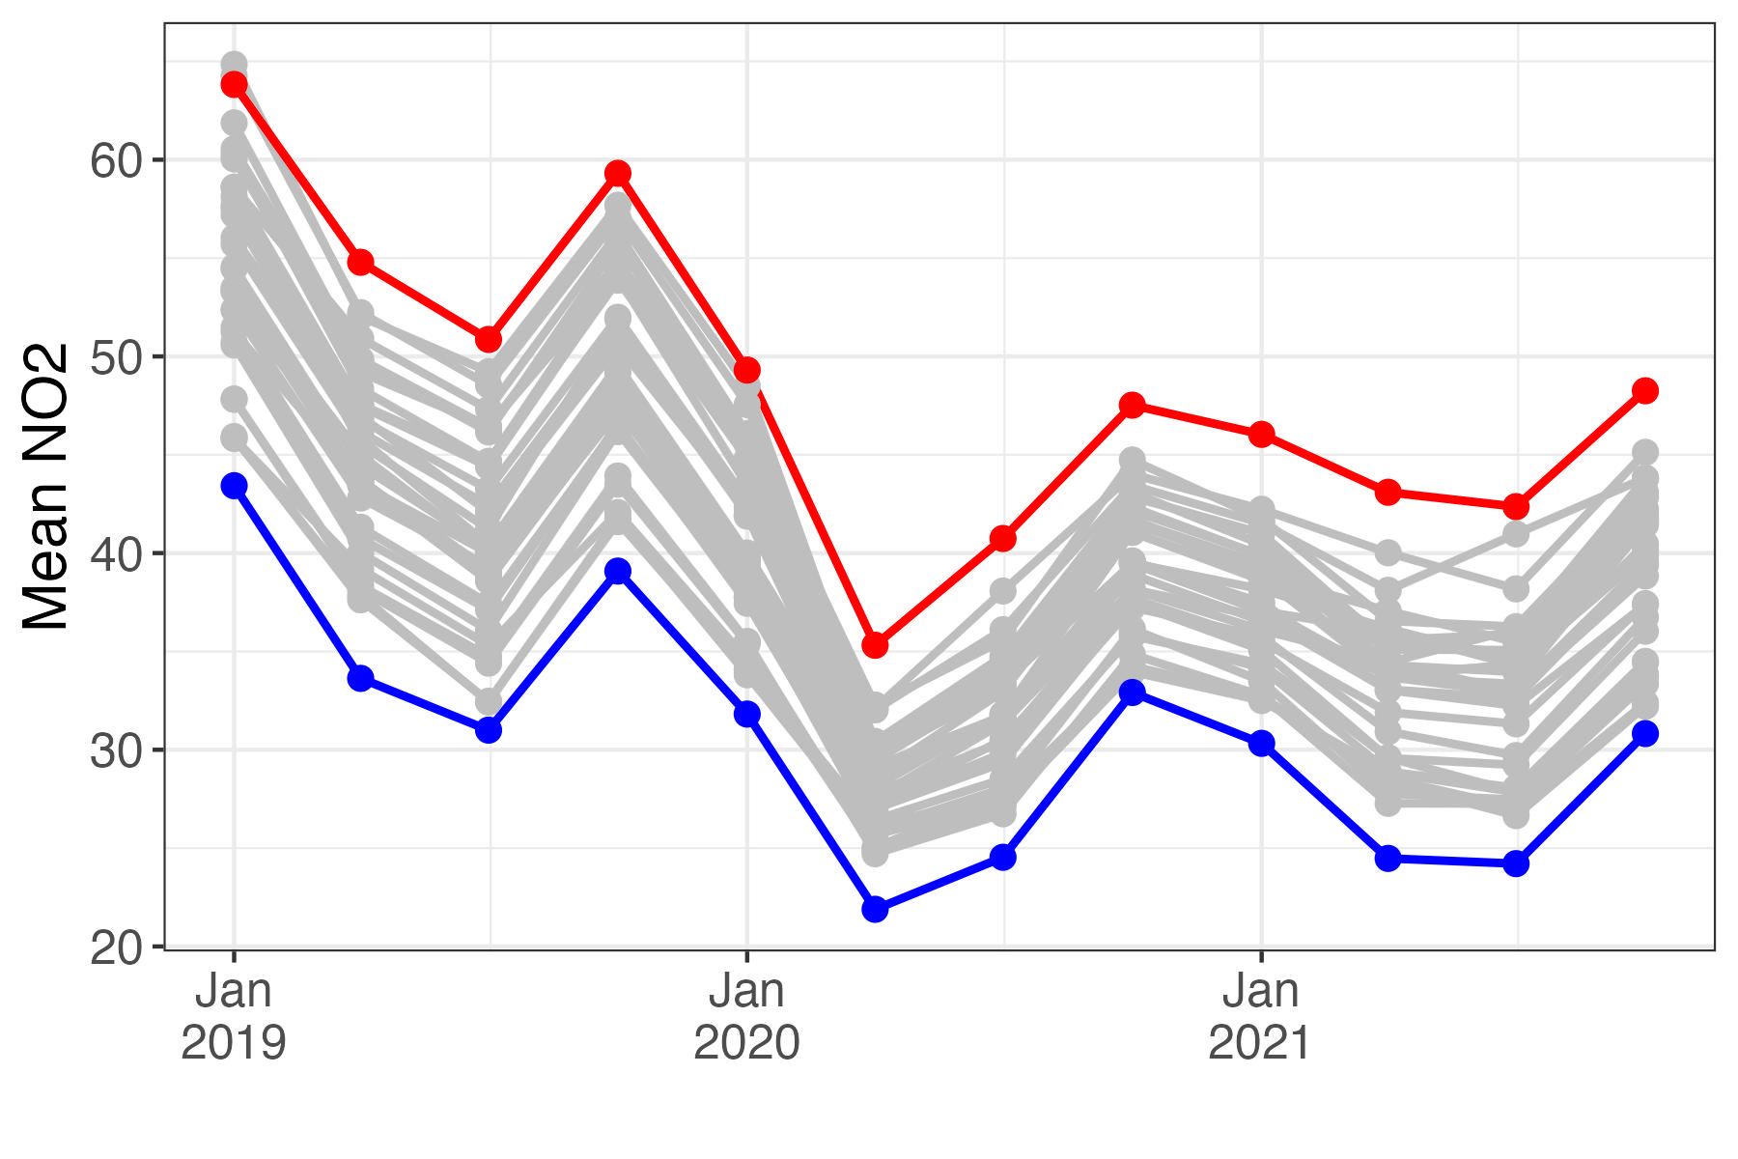
Mean Abs Diff: 17.7µg/m³
20.4
Lambeth
20.2
21.2
19.9
17.5
14.6
15.7
17.4
16.2
18.6
18.2
13.4
Havering

Slide 3
